Slide 1
A common neural basis for contrast and motion coherence discrimination
Dan Birman
Frisem 2017-06-26

Slide 4
Contrast

Slide 5
Coherence

Slide 6
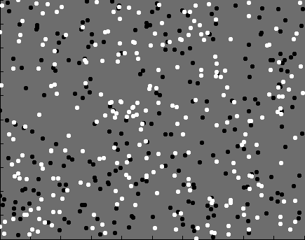

Slide 7
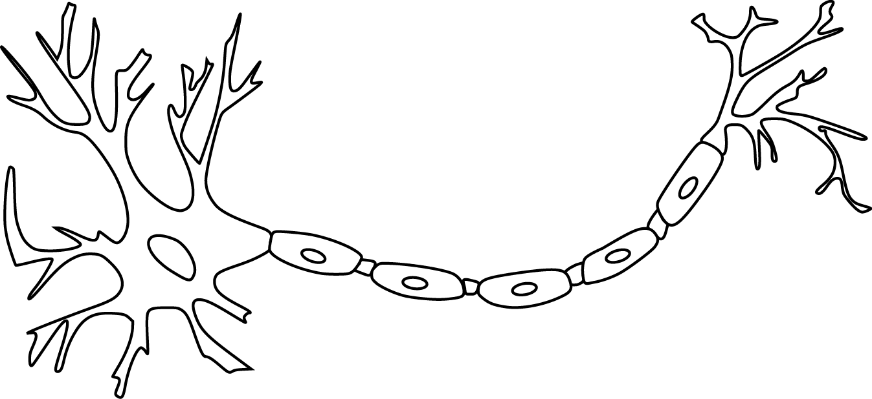

Slide 9
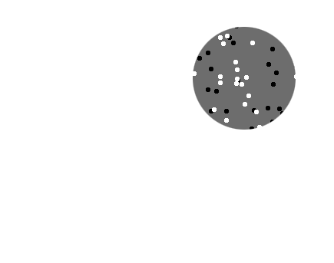
Receptive field

Slide 10
Receptive field

Slide 11
Population
Receptive field

Slide 13
~ 2.5 mm
~ 2.5 mm
~ 2.5 mm

Slide 14
~ 2.5 mm
~ 2.5 mm
~ 2.5 mm
Millions of neurons

Slide 16
Representation of contrast?
Boynton et al. 1999

Slide 17
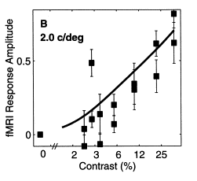
Representation of contrast?
Boynton et al. 1999

Slide 18
Representation of contrast?
Boynton et al. 1999
Representation of coherence?
Rees and Koch 2000

Slide 19
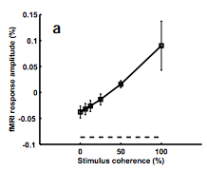
Representation of contrast?
Boynton et al. 1999
Representation of coherence?
Rees and Koch 2000

Slide 20
Representation of contrast?
Boynton et al. 1999
Representation of coherence?
Rees and Koch 2000

Slide 23
Contrast

Slide 24
Contrast

Slide 25
Contrast

Slide 26
Contrast
Coherence

Slide 27
Contrast
Coherence

Slide 28
Contrast
Coherence

Slide 29
Contrast
Coherence

Slide 30
Goal: A model of how voxels represent (encode) contrast and motion coherence

Slide 31
Goal: A model of how voxels represent (encode) contrast and motion coherence
Voxel representation from cortical measurements of BOLD fMRI
Prediction and comparison to a behavioral measure of visibility

Slide 32
Goal: A model of how voxels represent (encode) contrast and motion coherence
Voxel representation from cortical measurements of BOLD fMRI
Prediction and comparison to a behavioral measure of visibility

Slide 33
Goal: A model of how voxels represent (encode) contrast and motion coherence
Voxel representation from cortical measurements of BOLD fMRI
Prediction and comparison to a behavioral measure of visibility

Slide 37
Luminance changes = bad

Slide 43
Cortical measurements: task at fixation

Slide 44
Cortical measurements: task at fixation
11 observers, asynchronous task at fixation
800+ trials (20 per experimental condition)
1 hr retinotopy
4 x 2 hr scanning sessions

Slide 45
Area V1
Area MT

Slide 47
Within-subject analysis: display average across subjects

Slide 48
Within-subject analysis: display average across subjects
Timecourses were averaged across ROIs

Slide 49
Within-subject analysis: display average across subjects
Timecourses were averaged across ROIs
Deconvolution (GLM/finite impulse response) used to obtain separated per-condition measurements

Slide 51
Contrast

Slide 52
Contrast
Coherence

Slide 53
Contrast
Stimulus length
Coherence

Slide 56
Contrast

Slide 57
Contrast
Coherence

Slide 58
Contrast
Stimulus length
Coherence

Slide 64
Goal: A model of how voxels represent (encode) contrast and motion coherence
Voxel representation as measured from cortical signals with fMRI
Prediction and comparison to a behavioral measure of visibility

Slide 65
Goal: A model of how voxels represent (encode) contrast and motion coherence
Voxel representation as measured from cortical signals with fMRI
Prediction and comparison to a behavioral measure of visibility

Slide 72
Sensitivity = Response / Noise

Slide 76
Goal: A model of how voxels represent (encode) contrast and motion coherence
Voxel representation as measured from cortical signals with fMRI
Prediction and comparison to a behavioral measure of visibility

Slide 77
Goal: A single model of how voxels represent (encode) contrast and motion coherence
Voxel representation as measured from cortical signals with fMRI
Prediction and comparison to a behavioral measure of visibility

Slide 78
Goal: A single model of how voxels represent (encode) contrast and motion coherence
Voxel representation as measured from cortical signals with fMRI
Prediction and comparison to a behavioral measure of visibility

Slide 79
Goal: A single model of how voxels represent (encode) contrast and motion coherence
Voxel representation as measured from cortical signals with fMRI
Evidence for similar neural response functions to contrast and motion coherence
Prediction and comparison to a behavioral measure of visibility

Slide 80
Goal: A single model of how voxels represent (encode) contrast and motion coherence
Voxel representation as measured from cortical signals with fMRI
Evidence for similar neural response functions to contrast and motion coherence
Prediction and comparison to a behavioral measure of visibility

Slide 81
Goal: A single model of how voxels represent (encode) contrast and motion coherence
Voxel representation as measured from cortical signals with fMRI
Evidence for similar neural response functions to contrast and motion coherence
Prediction and comparison to a behavioral measure of visibility
Judgments of contrast and motion coherence appear to be read out from early visual cortex and MT in a similar way

Slide 82

Thanks!
Funding?
Other things?
Justin Gardner

